Slide 1
Applied Deep Learning
Module 7:
Chapter 11
Notes:
These are notes for the slide

Slide 2
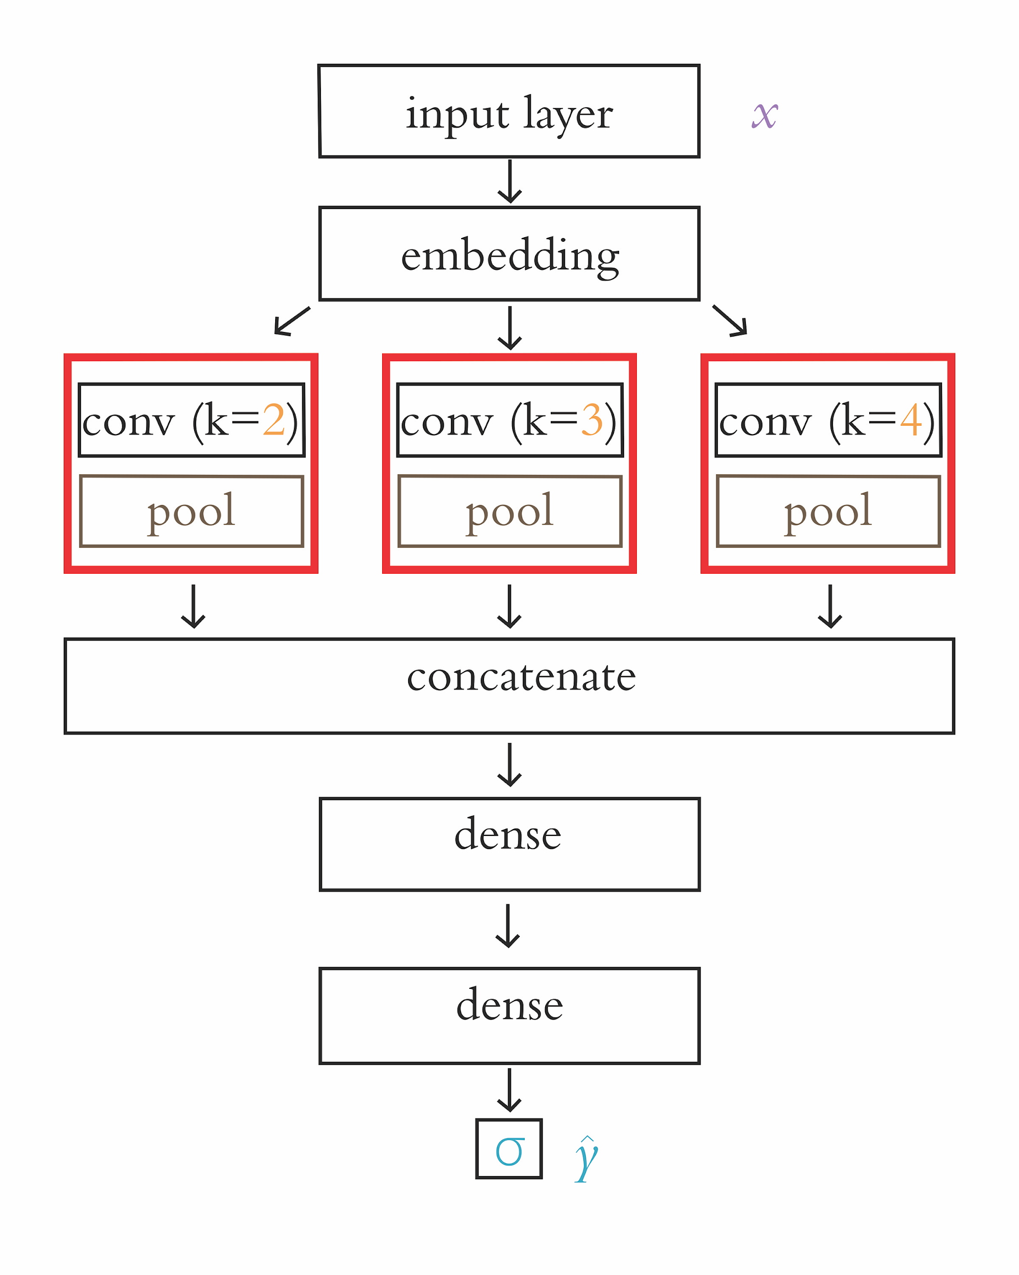
Chapter 11
Natural Language Processing

Slide 3
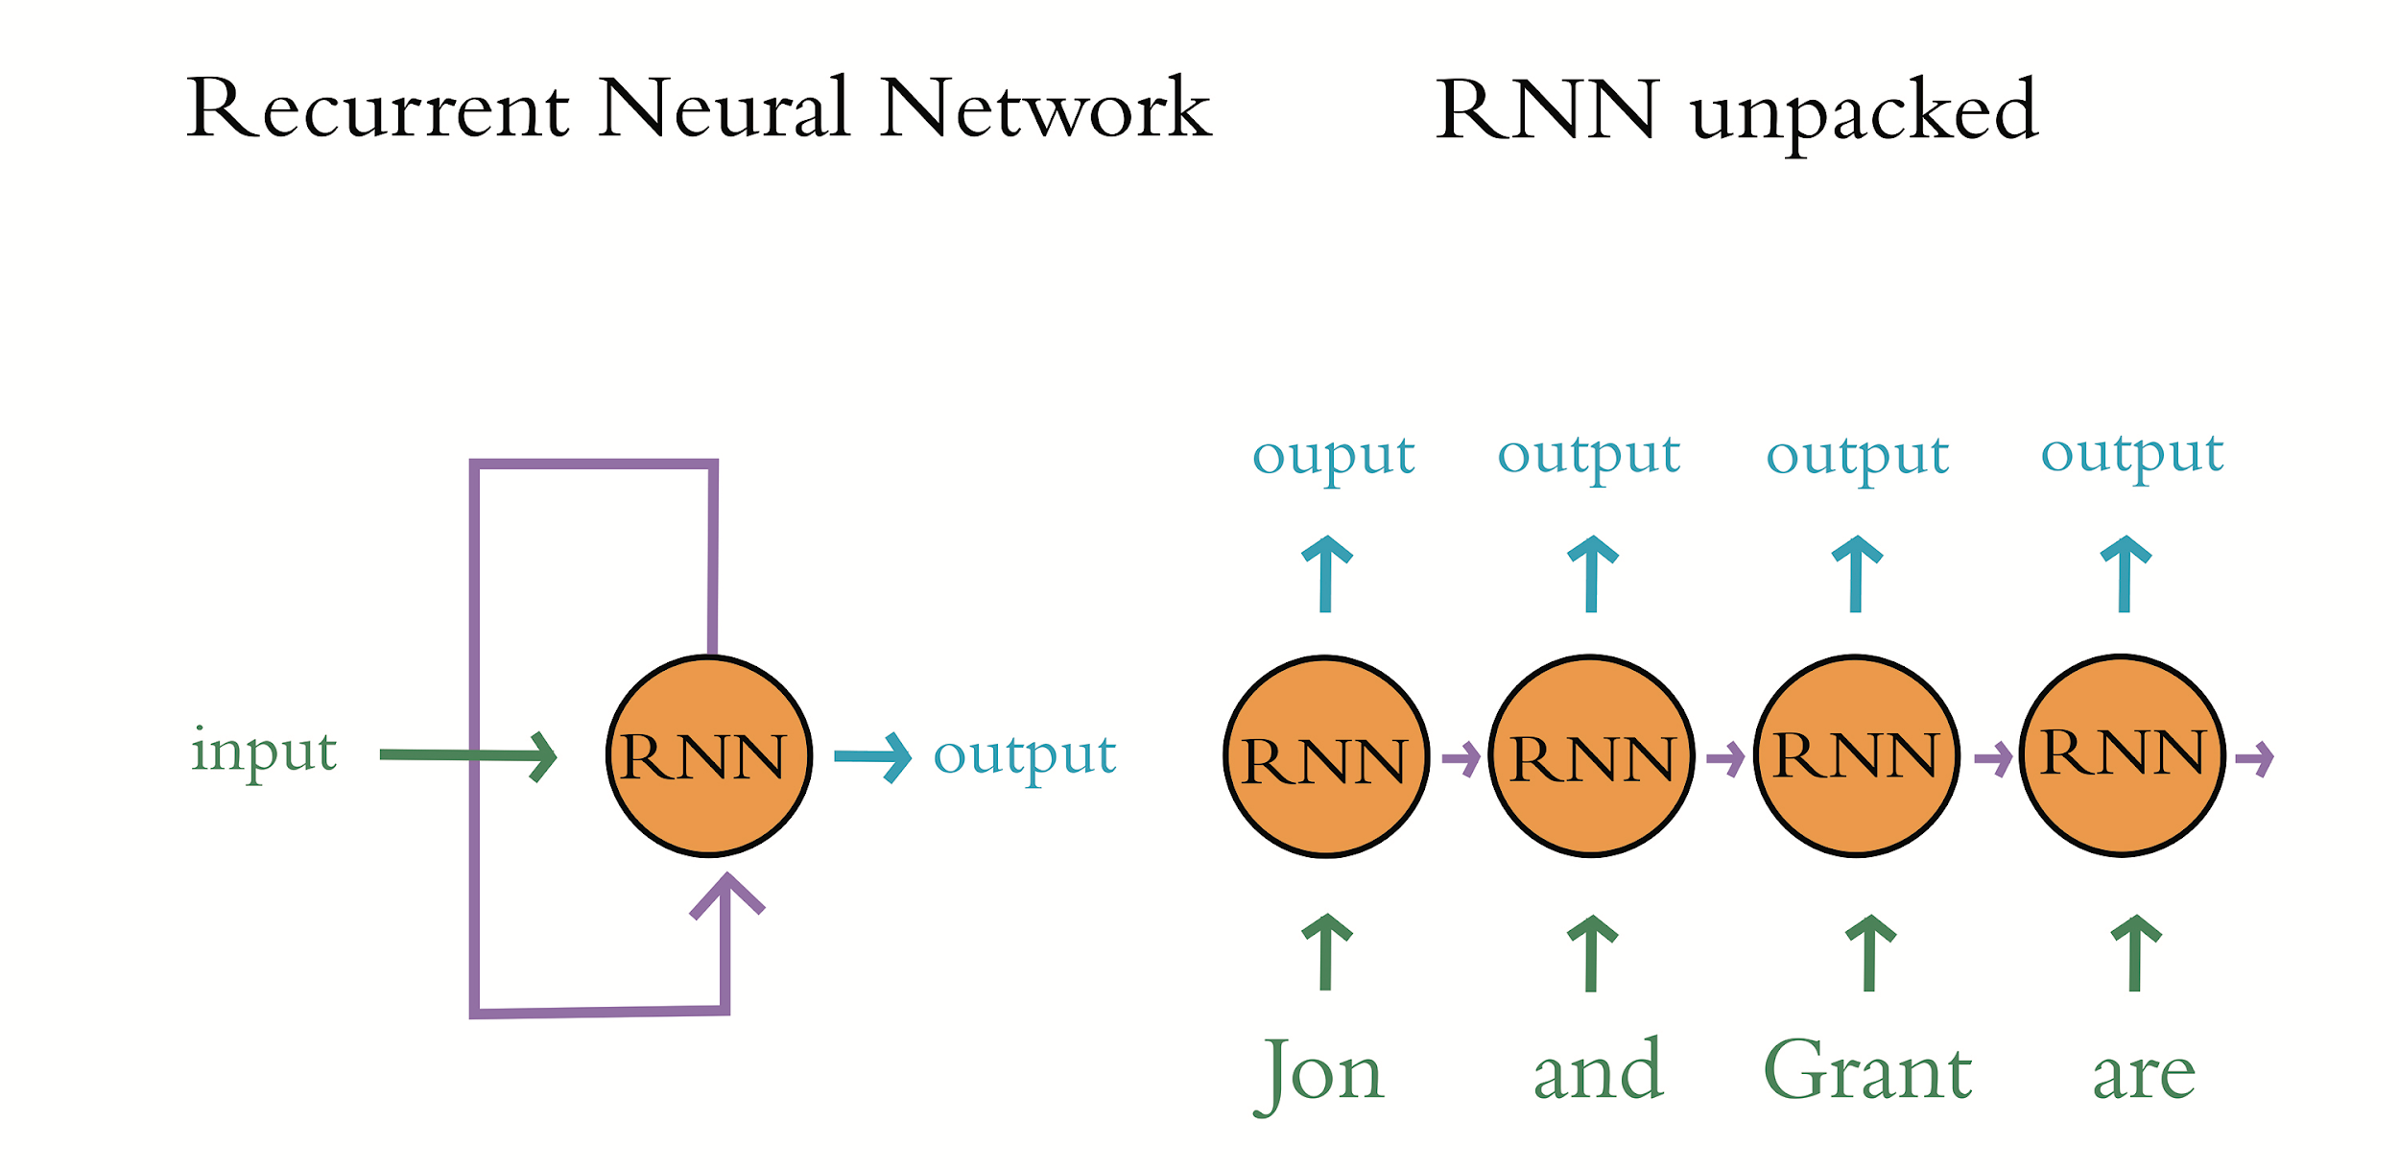

Slide 4
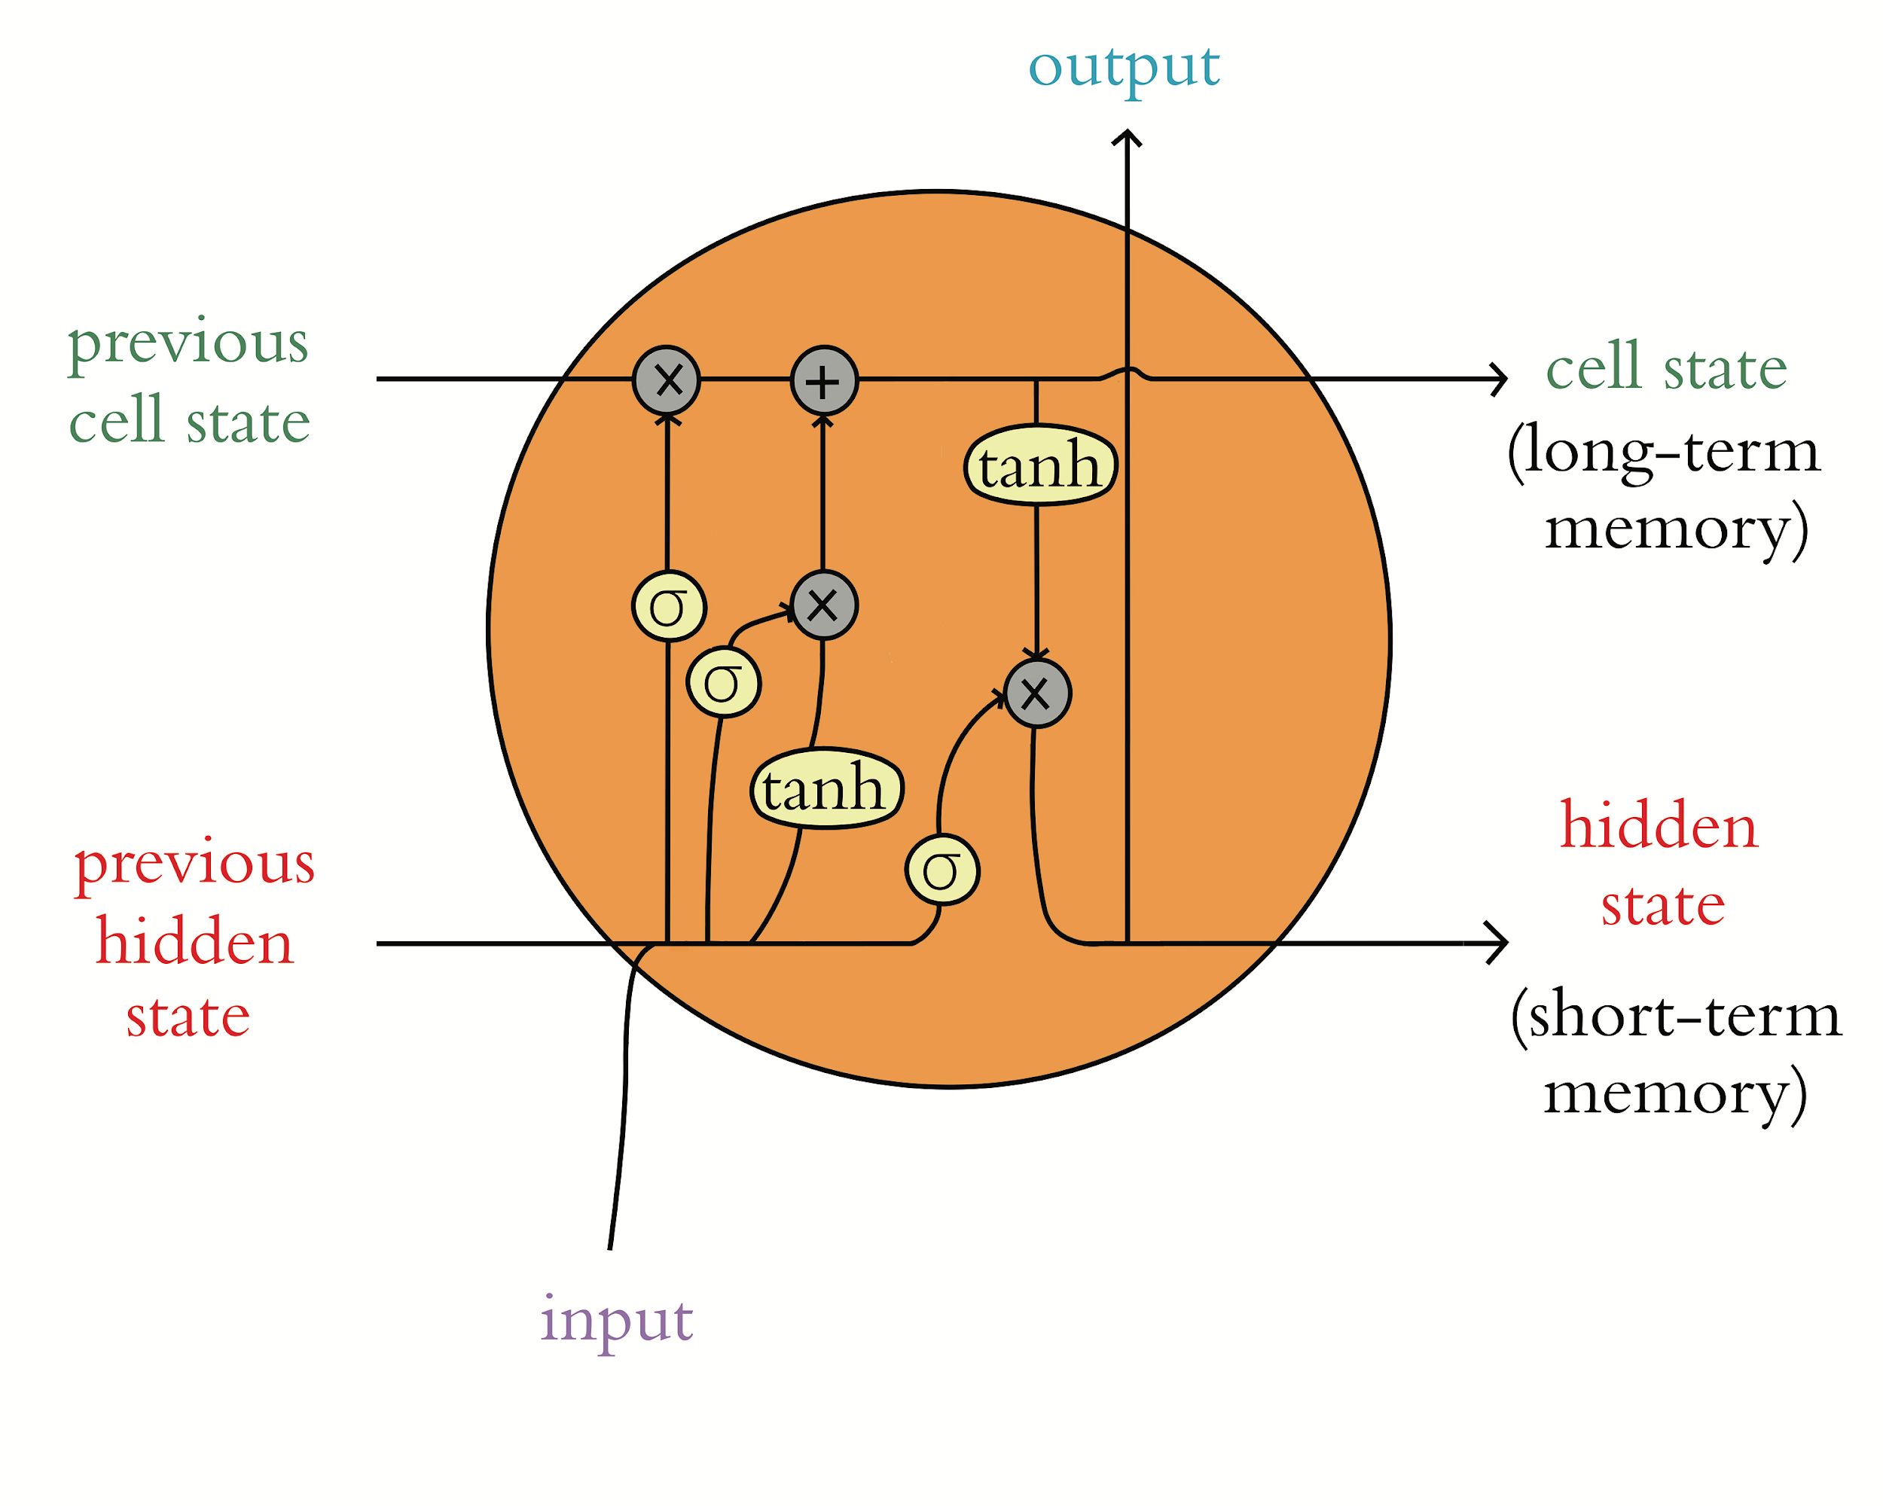

Slide 5
Datasets for NLP
Xiang Zhang et al.: bit.ly/NLPdata
Kaggle
Figure Eight: figure-eight.com/data-for-everyone
Luke de Oliveira: bit.ly/LukeData
jonkrohn.com/resources

Slide 6
Prominent seq2seq Model Concepts
Neural machine translation (NMT)
Attention

Slide 7
Models for Transfer Learning in NLP
ULMFiT
ELMo
BERT
RoBERTa / DistilBERT / etc.
GPT-2

Slide 8
A Non-Sequential Model Architecture

Slide 9
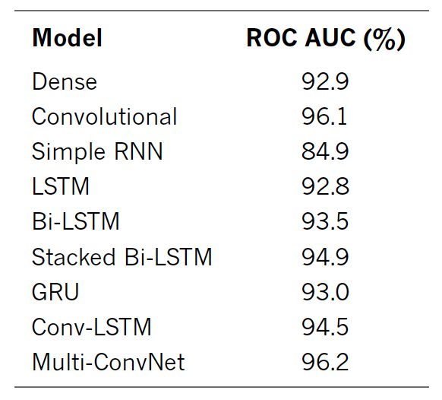
Performance of our Sentiment Classifiers

